Slide 1
Codex calculator
By:
Mr. Omar Hazem
Mr. Mohamed Hany
Mr. Abdelrahman Shady

Slide 2
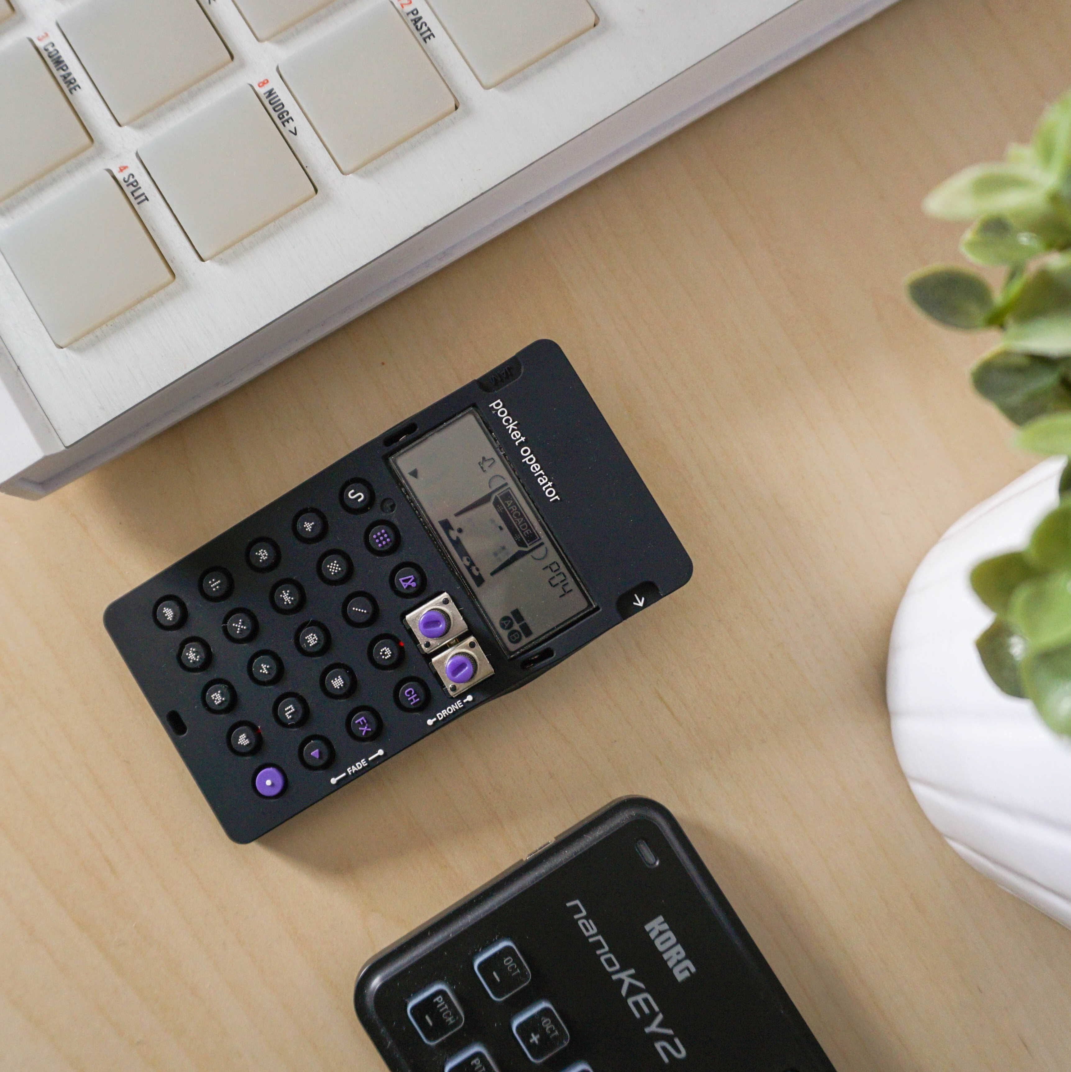
Agenda
Introduction
Main Functions
Benefits
Costs

Slide 3
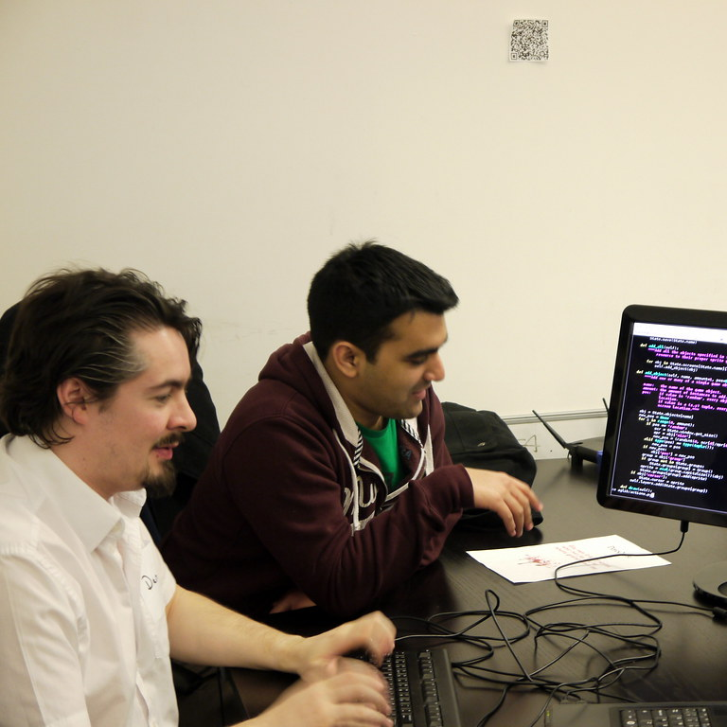
Introduction
Codex Calculator aims to provide an easy means to calculate a decent amount of simple mathematical operations/conversions; This PowerPoint will help the presenter deliver this idea.

Slide 4
How does it Function?
A brief look…

Slide 5
The Functions
The usage of separated files to hold the functions & the Interface for easier access.
The Calculation of Areas
Volume equations.
Simple Mathematical Operations.
Unit Conversions & Trignometrics.

Slide 6
The Distribution Table
 | Area | Volume | Simple Operations | Unit Converter/ Trignometrics
Functions Count | 10 | 7 | 5 | 32
Brief Description | Calculates the area of 10 shapes | Calculates the volume of 7 different shapes | Performs addiction, subtraction, mult., div., and power functions | Performs distance, weight, and radical conversion/ Performs 6 Trig.

Slide 7
Timeline
Introduction
Introducing the project in an attractive manner.
Function Types
It will be explained in detail what functions are included within the calculator
Beneifts
During the presentation, the positive outcomes of the project will be discussed
Costs
The Costs of Implementation will be mentioned in a slide
Summary
The Slide will aim to summarize all possible points of interest.

Slide 8
Benefits
Profit
Improvement room
The Profit of uploading the calculator online will compensate spendings.
Once copyrights are gained, it can bring revenue for individual usage.
The Design allows for future modification to the Calculator to include more functions.
The UI is Versatile with customization.
Time Saving.

Slide 9
Costs
Feedback
Server
Website Operations
Customer Feedback is constantly a priority to improve bugs that might appear in the future.
A Server setup will be required for essential functions & calculations.
The costs of using a domain to upload the Calculator to the web for public use will require funds.

Slide 10



Summary
With this calculator, one can use it commercially & attract profit since many students nowadays use online calculators for their academic studies. This can be used to this Calculator into a potential successful idea.

Slide 11



Team
Abdelrahman Shady
Omar Hazem
Mohamed Hany

Slide 12
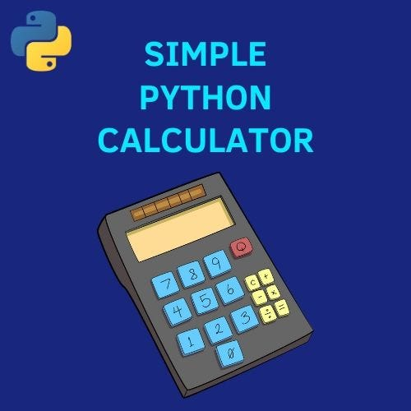


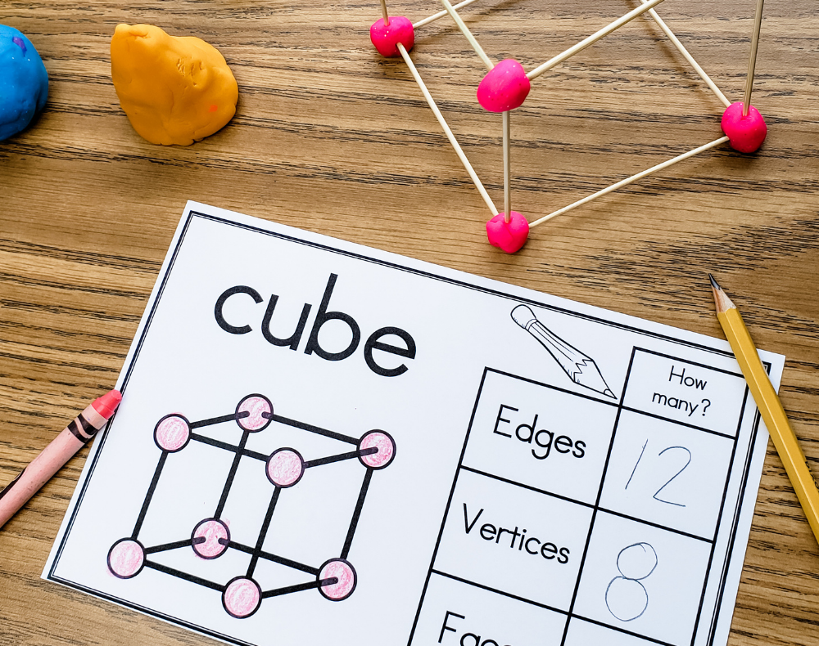
Thank you
A. Shady, O. Hazem, & M. Hany
www.Codex.net

